Slide 1
IoT Security
Academy of Cryptography Techniques
CHAT
Dr. Pham Van Huong
0902 122 010
HuongPV@gmail.com

Slide 2
Contents
1
Basic concept
2
IoT architecture
3
Protocols in IoT
4
4
Applications of IoT
5
5
4
Threat analysis in IoT
5

Slide 3
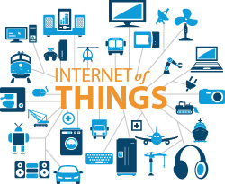
Basic concepts
The Internet of things (IoT)
Describes physical objects (/groups of objects) with sensors, processing ability, software, and other technologies that connect and exchange data over the Internet or other communications networks

Slide 4
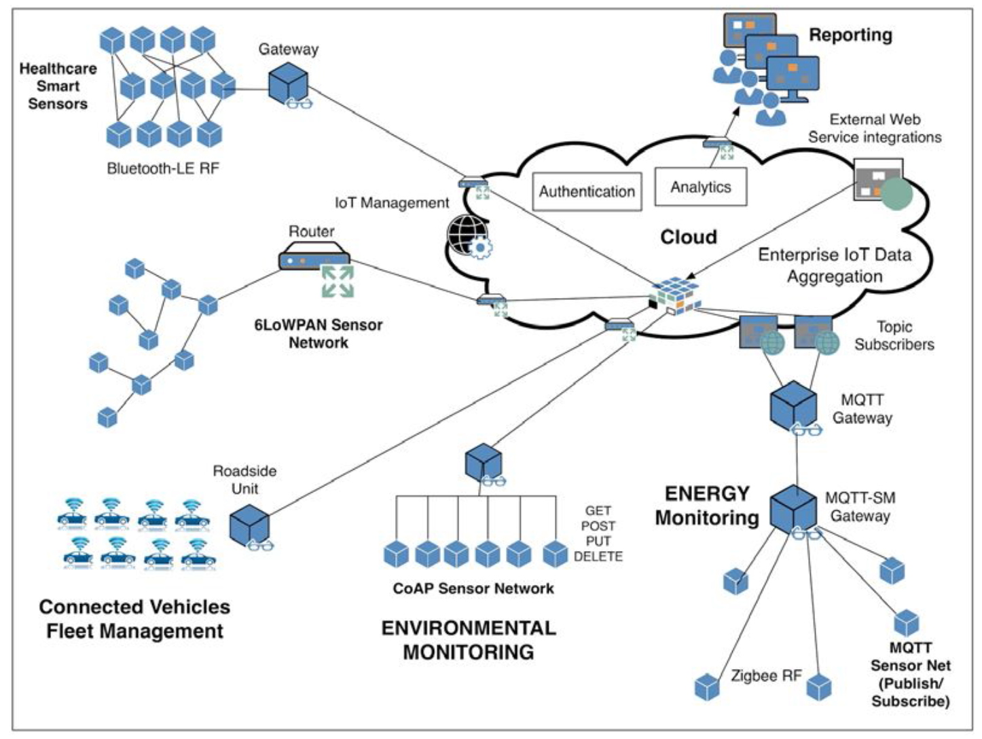
IoT architecture

Slide 5
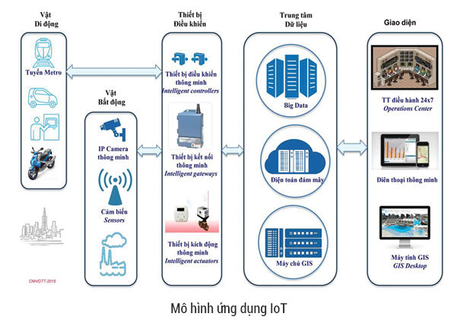
IoT architecture
IoT system
Server + desktop + Mobile + Board (IoT gateway )

Slide 6
IoT components
The hardware
Arduino, Beagle Board, Pinoccio, Rasberry Pi, and CubieBoard
Operating systems
Real time operating system (RTOS): TinyOS, Contiki, Mantis, FreeRTOS, BrilloOS, Embedded Linux, ARM's mbedOS, and Snappy Ubuntu Core
IoT communications
An IoT device communicates with a gateway that in turn communicates with a controller or a web service
Messaging protocols
Protocols such as the MQTT, the Constrained Application Protocol (CoAP), the Data Distribution Service (DDS), the Advanced Message Queuing Protocol (AMQP), and the Extensible Messaging and Presence Protocol (XMPP)

Slide 7
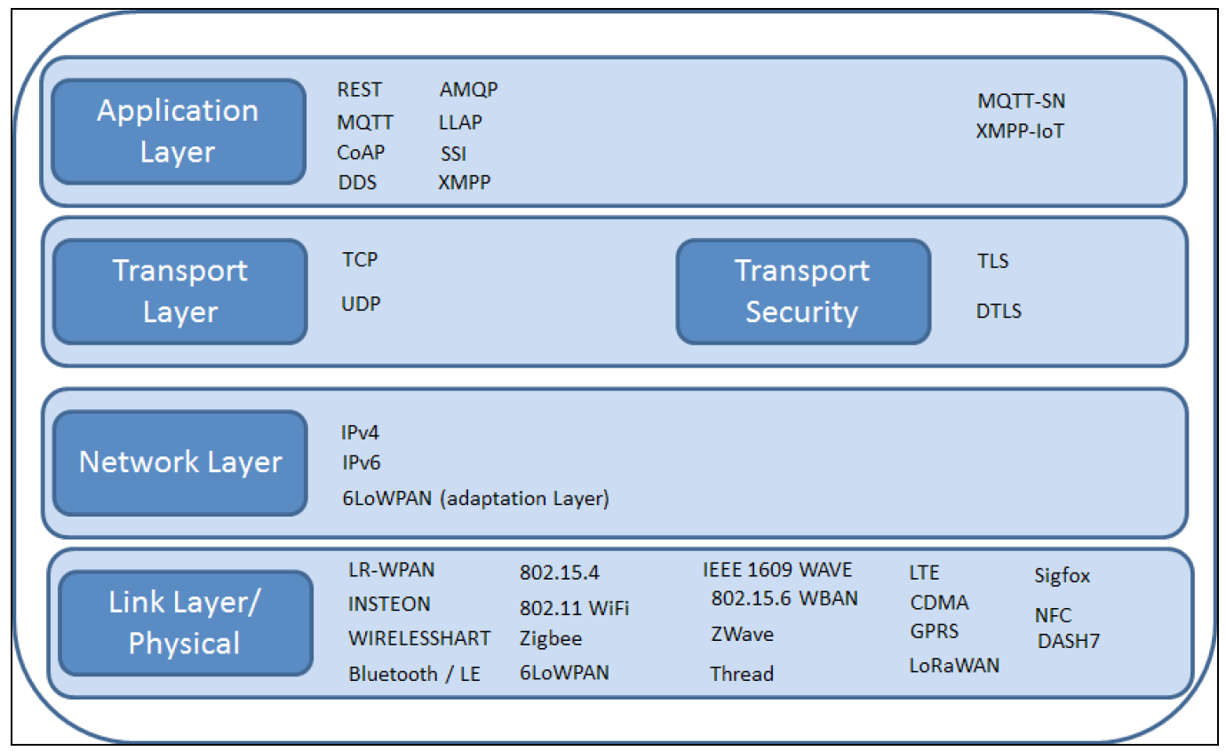
Protocols in IoT

Slide 8
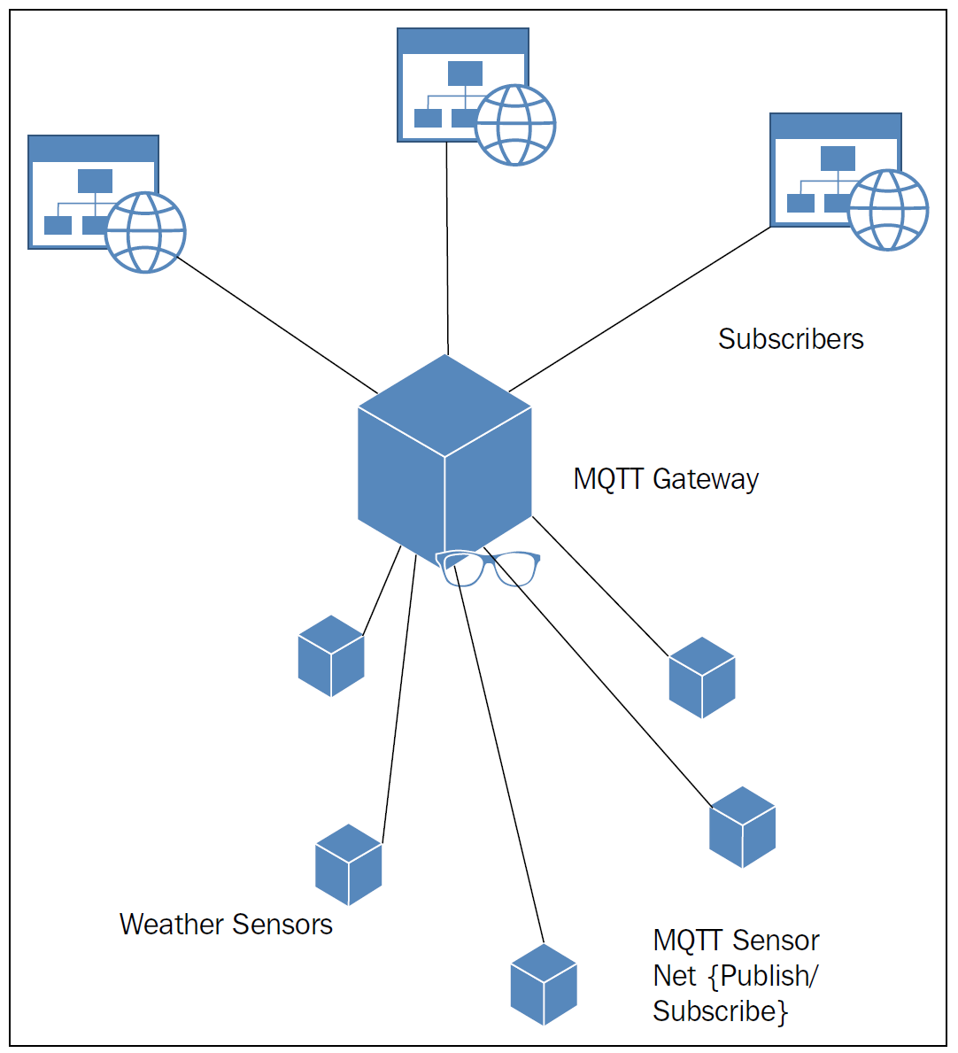
MQTT
MQTT is a publish/subscribe model
Clients subscribe to topics and maintain an always-on TCP connection to a broker server
As new messages are sent to the broker, they include the topic with the message, allowing the broker to determine which clients should receive the message and push message to them

Slide 9
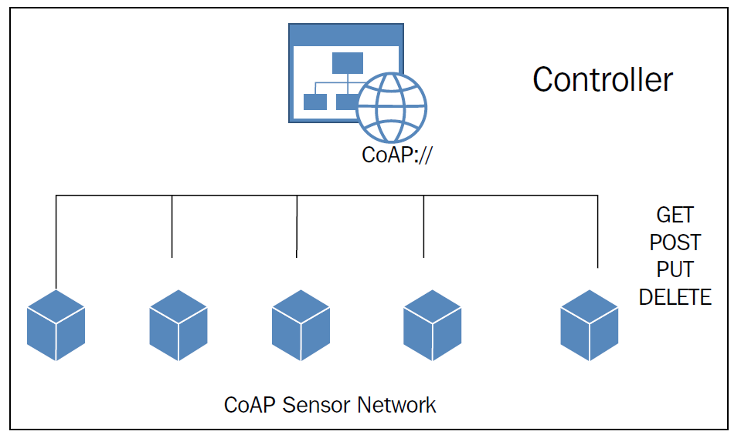
CoAP
CoAP based on UDP, and intended for use in resource-constrained Internet devices such as WSN nodes. It consists of a set of messages that map easily to HTTP: GET, POST, PUT, and DELETE.

Slide 10
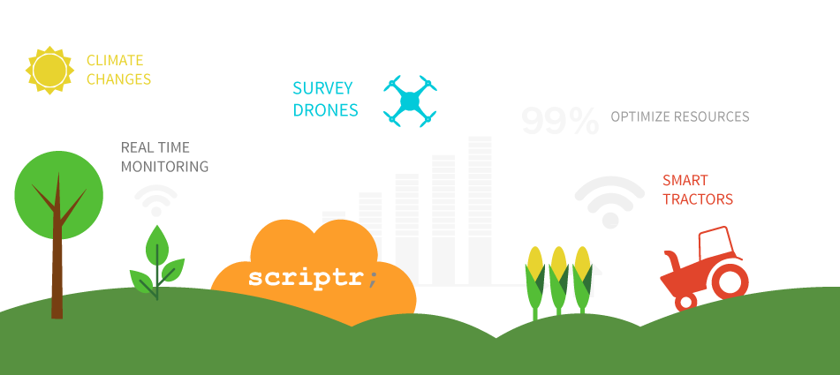
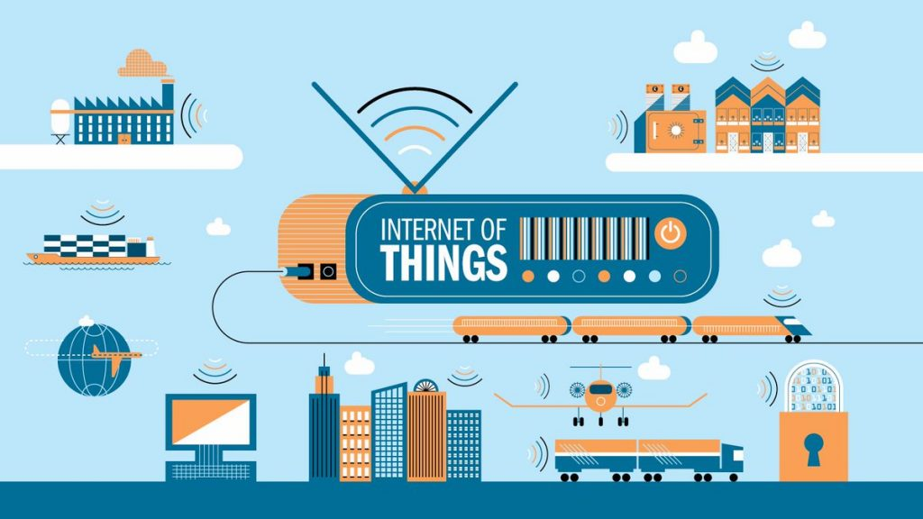
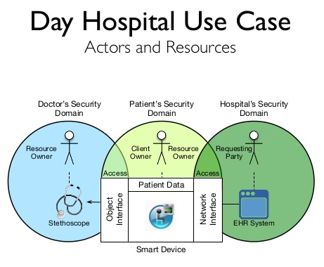
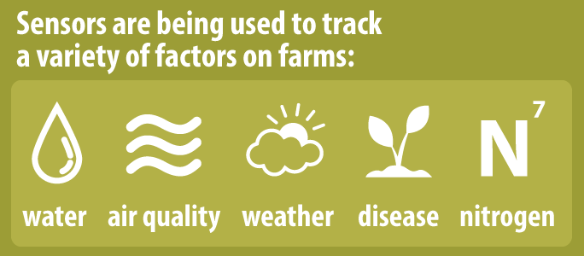
Applications of IoT
IoT is used and will be used in almost every industry possible
Academic
Transport
Logistics
Healthcare & Tracking
Agriculture
Smart Cities
Entertainment

Slide 11
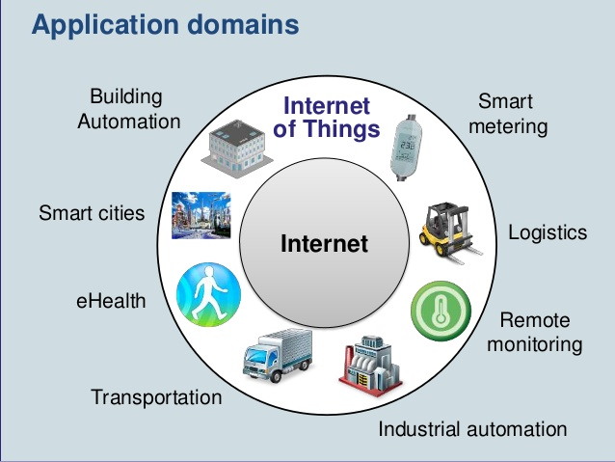
Applications of IoT

Slide 12
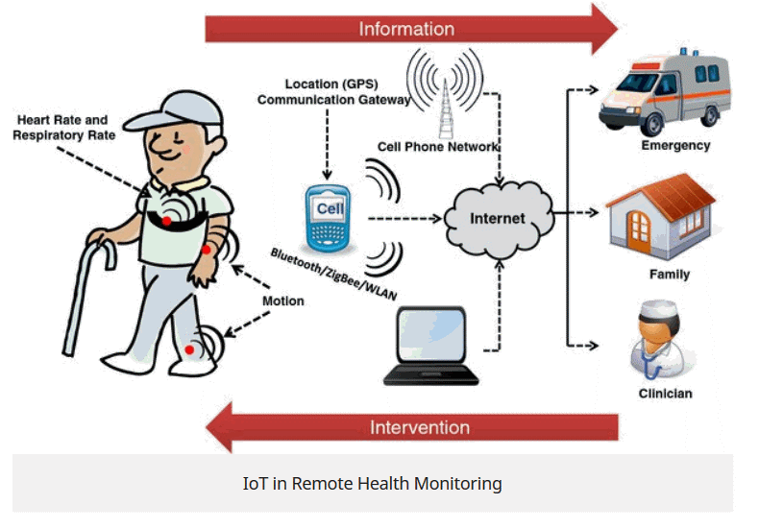
IoT in Health

Slide 13
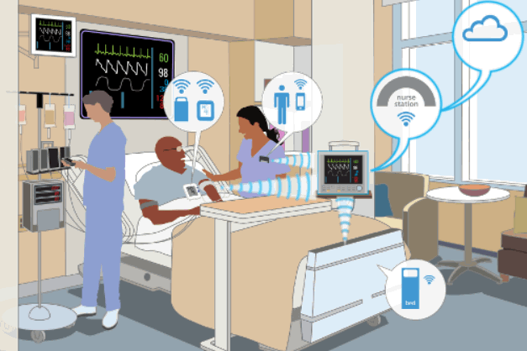
IoT in Health

Slide 14
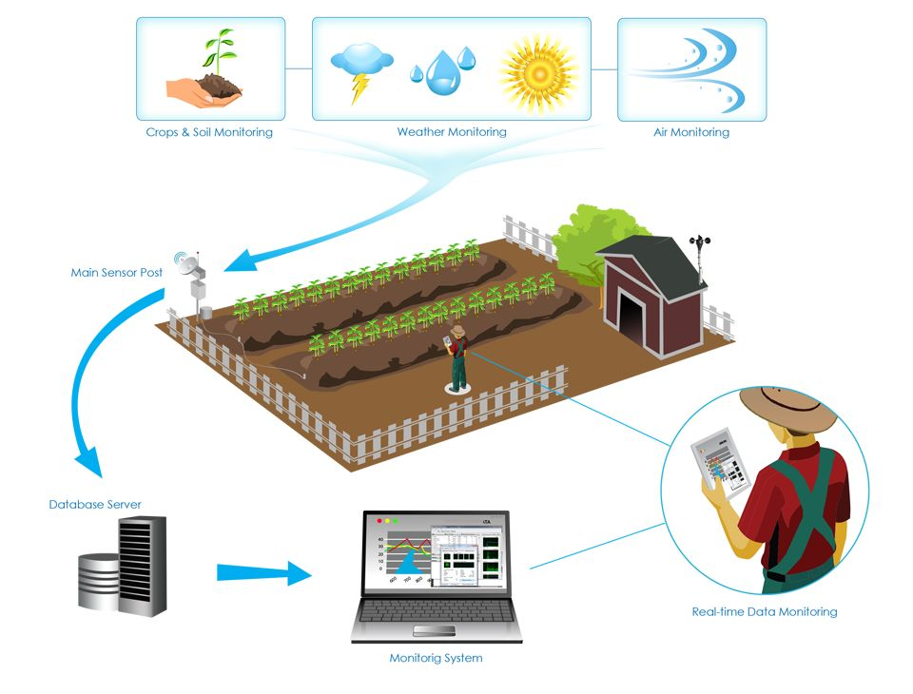
IoT in Agriculture

Slide 15
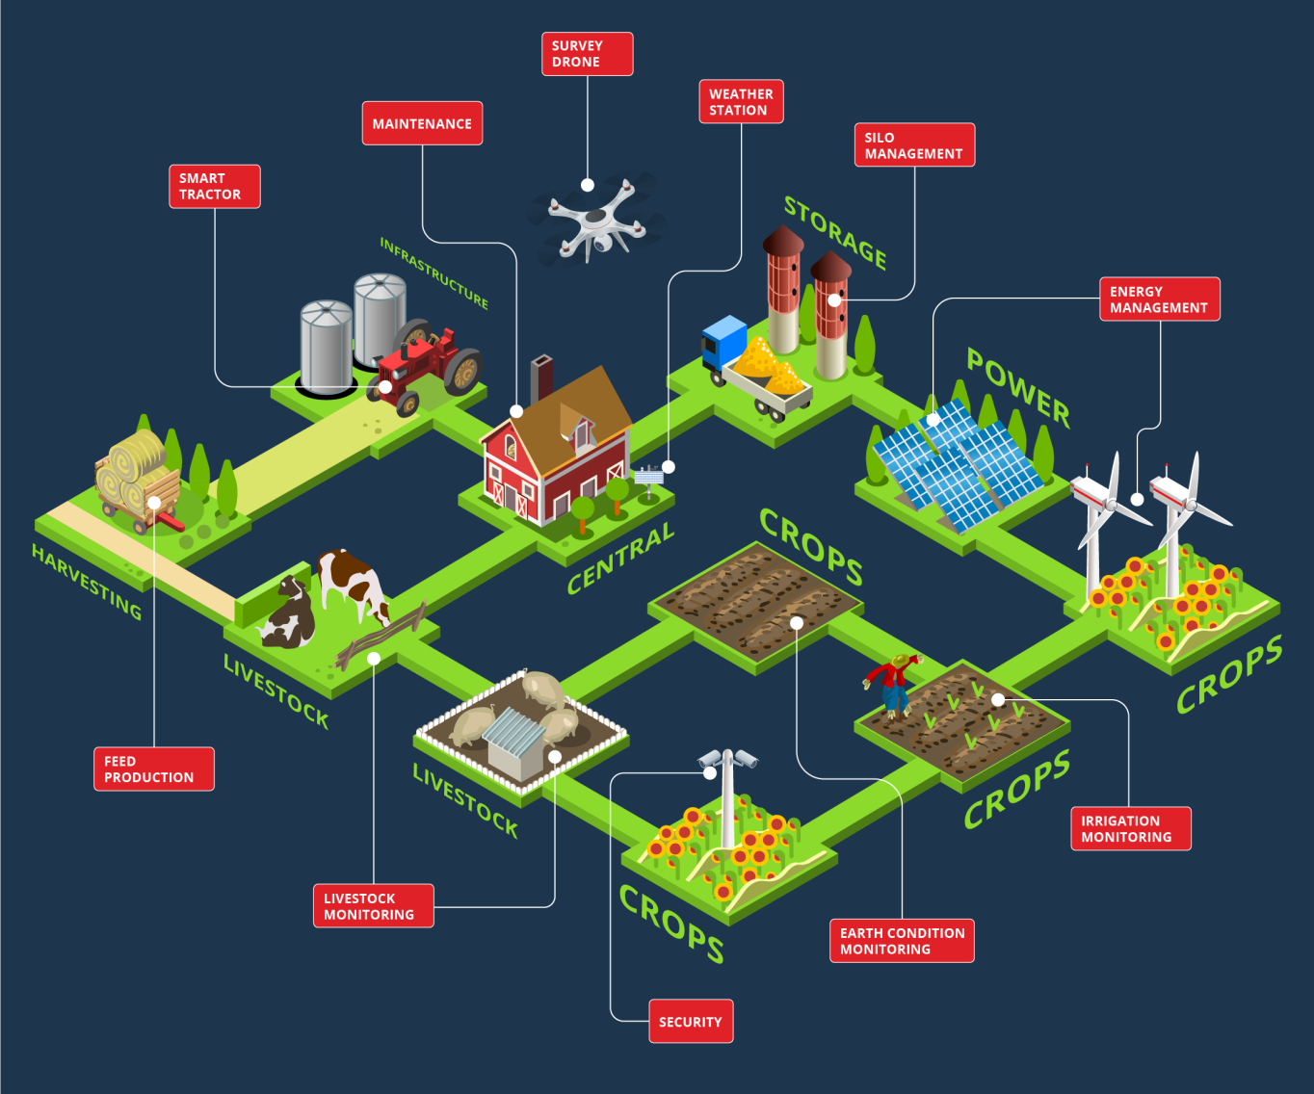
IoT in Agriculture

Slide 16
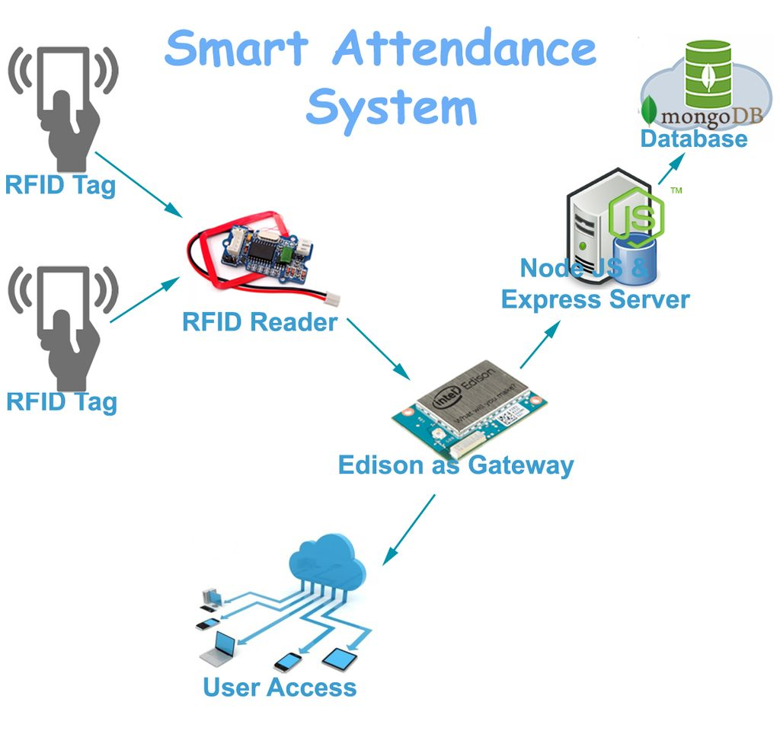
IoT in Eduction

Slide 17
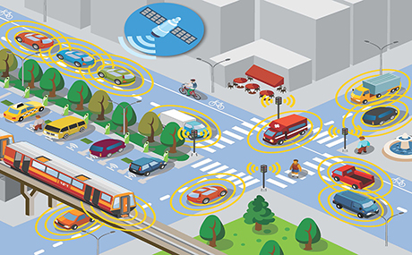
IoT in Traffic

Slide 18
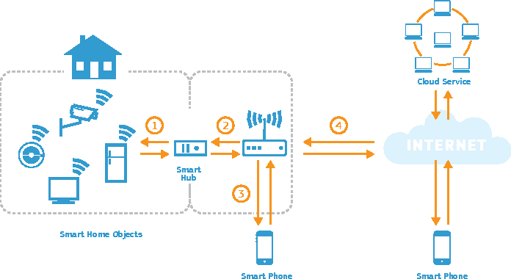
IoT in Smart Home

Slide 19
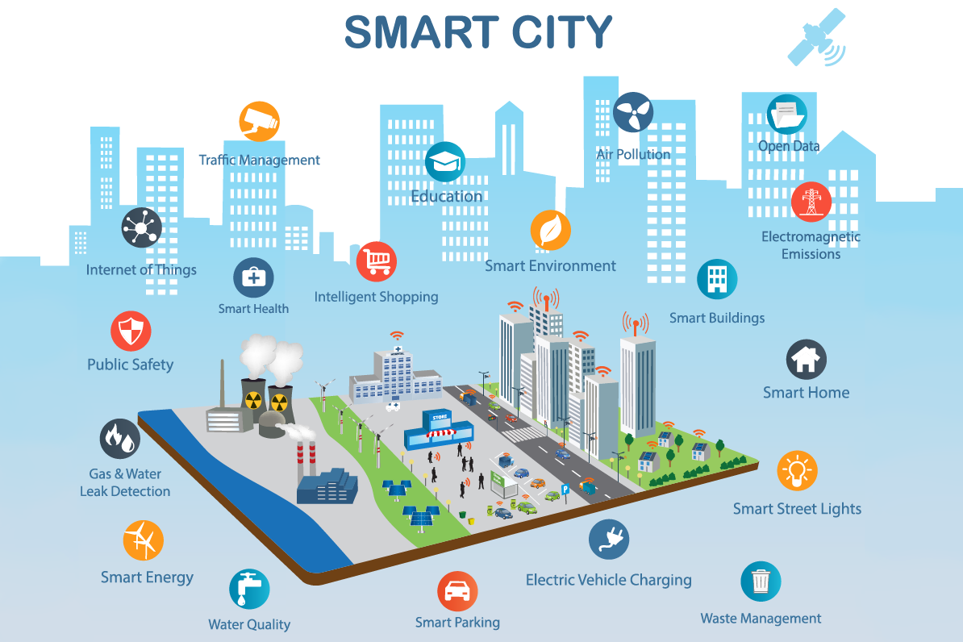
IoT in Smart Cities

Slide 20
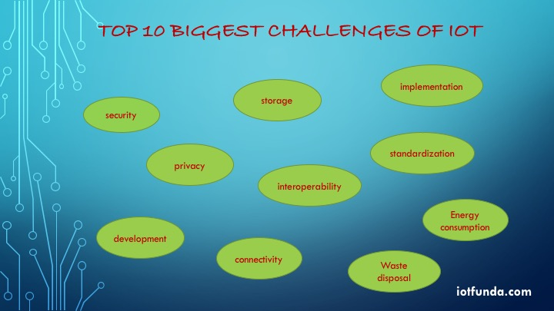
Challenges of IoT
Object Naming
Data Conversion
Privacy
Interoperability
Security
Quality of Service
Data Encryption and Key Management
Network Issues (Traffic Congestion)

Slide 21
Threat analysis in IoT

Slide 22
Q&A

